Slide 1
Newcomers
Social Studies 7
Ms. D. McKean

Slide 2
Europeans
Most early immigrants were French and English
Many left homeland because they wanted more land
Some left because they thought their culture and religions should be spread around the world

Slide 3
Europeans
Also looking for natural resources, such as timber, furs, fish, seal oil and pelts, and minerals

Slide 4
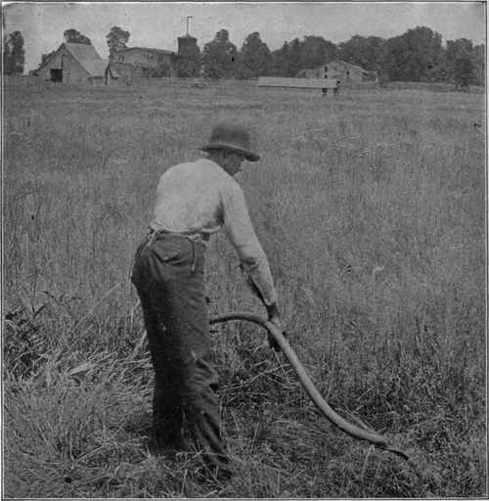
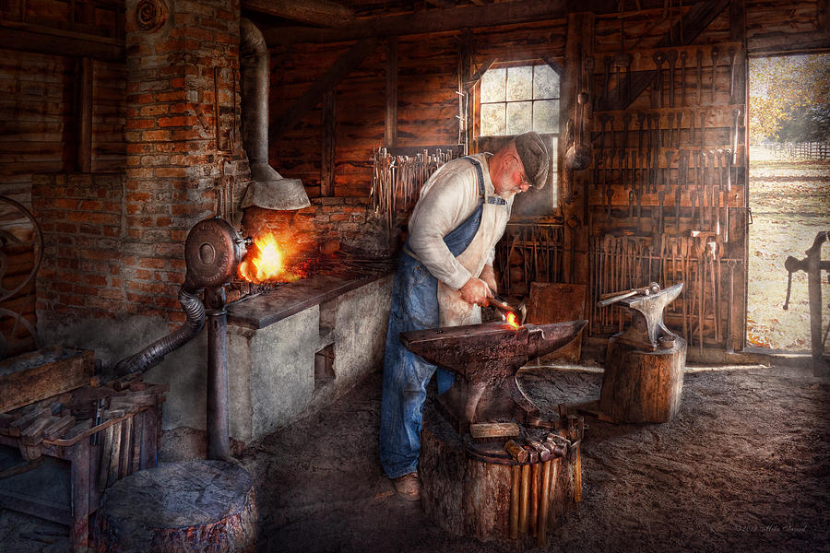
Production of Goods
Until 1700s basic tools were made by hand and work was completed with the help of animals
Some goods produced by specific tradespeople
Farmers produced most of their own goods

Slide 5
How Did Their Economy Work?
Economic system based on idea that if you owned land/ resources, you had a right to make as much profit as possible
Money and markets

Slide 6
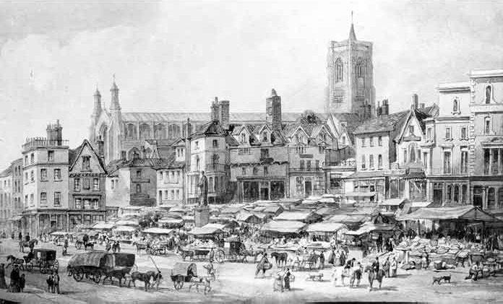
How Did Their Economy Work?
Making due with what they brought with them, could make themselves, or could get by trading
Hoped to set up market system found in Europe

Slide 7
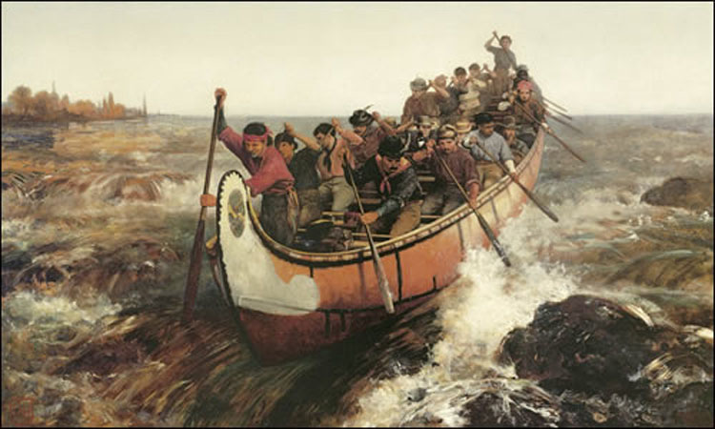
Key Resources
Fish
Furs
Timber

